Slide 1
Computational intelligence Hidden Markov Model
Suraj Sanath Kumar Bharadwaj-1224681
29-Jan-2019

Slide 2


Why use Hmm?
Model Sequence of data.
Stock prices,language,credit scoring,webpage visits

Slide 3
Hidden Markov Model
Hidden
+
Markov Model
What is Hidden?
What is Markov Model?

Slide 4
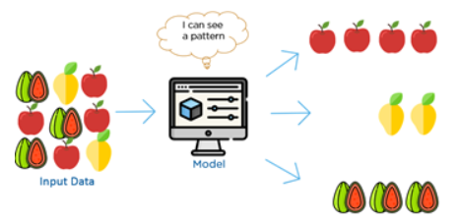
HMM Supervised or Unsupervised?
• Unsupervised learning -model a distribution but don't have any labels
• Supervised learning -when we have labels
• HMMs are for modeling sequences: x(1), x(2), ..., x(t), x(T) There's no label here
Therefore UNSUPERVISED
https://www.quora.com/What-is-the-difference-between-supervised-and-unsupervised-learning-algorithms
2

Slide 5
Markov Process
Stop Prepare to Go Proceed Prepare to stop
Traffic Lights- the sequence is red -red/amber -green -amber -red.
The sequence – is a state machine (trellis diagram),
States- traffic lights which follow each other.
each state is dependent solely on the previous state.
observable Markov process

Slide 6

Markov Model: Scenario Classify a weather into three states: State 1: rain State 2: cloudy State 3: sunny
Rain Cloudy Sunny
0.3
0.6
1:
Rain
2:
Cloudy
 |  | Tomorrow
 |  | Rain | Cloudy | Sunny
Today | Rain | 0.4 | 0.3 | 0.3
 | Cloudy | 0.2 | 0.6 | 0.2
 | Sunny | 0.1 | 0.1 | 0.8
0.4
0.2
0.3
0.1
0.2
0.1
3:Sunny
Assumption: tomorrow’s weather depends only on today’s one!
0.8

Slide 7
Markov Model: Definition
0.3
0.6
0.2
0.8
1:
Rain
2:
Cloudy
a₁₁
0.4
Each state corresponds to one observation
A(i : ) must sum to 1.
Each state can go to each state, including itself
Initial state Distribution: π_{i} = (s₁ = i)
Observable states : {1,2,….N} N states → N*N weights
Observable sequence: q1,q2,…,qT
Assumption: P (q_{t} =j|q_{t-1}= i,q_{t-2}= k,…)=P(q_{t} =j|q_{t-1} = i)
Transition Matrix : A→ N*N matrix A =
A(i, j)=p( s(t)=j | s(t-1)=i )
0.3 0.1
0.2 0.1
3:Sunny
a₁₁ a_{12 . . .} a_{1N}
a₂₁ a_{22 . . .} a_{2N}
. . . .
. . . .
a_{N1} a_{NN . . .} a_{NN}

Slide 8
0.3
0.6
0.2
0.8
0.4
1:
Rain
2:
Cloudy
What is the probability that the weather for the next 7 days will be sun-sun-rain-rain-sun-cloudy-sun when today is sunny?
0.3 0.1
0.2 0.1
3:Sunny
S_{1:} rain , S₂ :Cloudy, S₃ : Sunny
P(O | model) = P(S₃, S₃, S₃, S₁, S₁, S₃, S₂, S₃ | model)
=P(S₃) . P(S₃ | S₃) . P(S₃ | S₃) . P(S₁ | S₃) . P(S₁ | S₁) . P(S₃ | S₁) . P(S₂ | S₃) . P(S₃ | S₂)
= π₃ . a₃₃ . a₃₃ . a₃₁ . a₁₁ . a₁₃ . a₃₂ . a₂₃
= 1 . (0.8)(0.8)(0.1)(0.4)(0.3)(0.1)(0.2)
= 1.536*10⁻⁴
 |  | Tomorrow
 |  | Rain | Cloudy | Sunny
Today | Rain | 0.4 | 0.3 | 0.3
 | Cloudy | 0.2 | 0.6 | 0.2
 | Sunny | 0.1 | 0.1 | 0.8
p( s(0),..,s(T) ) = π (s(0)) Π_{t=1..T} p( s(t) | s(t-1) )

Slide 9
Hidden markov model Example:
2
0.3
0.2
0.6
1
0.1
0.1
3
0.6
0.2
0.6
0.3
N =3 urns containing Color balls
M distinct colors
Every urn has different number of color balls

Slide 10
HMM generation process:
3
1
1
Sequence generating algorithm
Step 1: Pick initial urn according to some random process
Step 2: Randomly pick a ball from the urn and then replace it
Step 3: Select another urn according to a random selection process
Step 4: Repeat steps 2 and 3

Slide 11
HMM : Hidden Info
We can just observe the chosen ball
From which urn it was chosen at a time
Urn selection is hidden

Slide 12
N = Number of states
HMM: Elements
Notation: λ=(π,A,B)
M = number of symbols observable in states v={v₁,v₂…V_{M}}
π: Initial state distribution
=P(q₁=i)
π_{i}
A: State transition probability
distribution A={a_{ij} }
B: Observation symbol probability
distribution B = {b_{j}(v_{k}) }

Slide 13
Back to the Example
2
0.3
0.2
0.6
No of states: N=3
No of Observation: M=3
V={R, G, B}
={P(q₁=i)}=[1,0,0]
A= {a_{ij}} =
0.1
1
0.1
3
0.6
0.2
0.6
0.3
π
0.6 0.2 0.2
0.1 0.3 0.6
0.3 0.1 0.6
State Transition probability distribution
B = { b_{j} (v_{k}) } =
3/6 2/6 1/6
1/6 3/6 2/6
1/6 1/6 4/6
Observation symbol probability distribution

Slide 14

HMM AssumptionS:
current state depends only on the previous state.
P(q_{t} |q_{t-1})
observation at time (t) depends only on the state at Time (t)
P(O_{t} |q_{t})
https://www.cityu.edu/blog/underlying-assumptions-and-organizational-change/
q₁
q₂
q_{t-1}
q_{t}
O₁
O₂
O_{t-1}
O_{t}

Slide 15

Number Of Hidden states???
# of states can reflect real physical situation or a priori knowledge
URN example - we know there are 3 urns
https://www.kanbanchi.com/project-management-software
Speech-to-text: we know the number of words in vocabulary
Biology: codon = sequence of 3
DNA/RNA nucleotides —> amino acids
Knowledge!!!!!

Slide 16
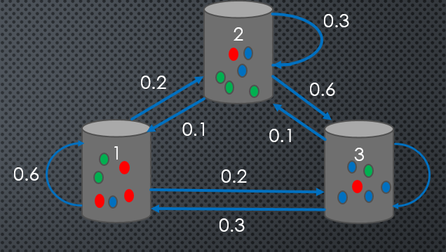

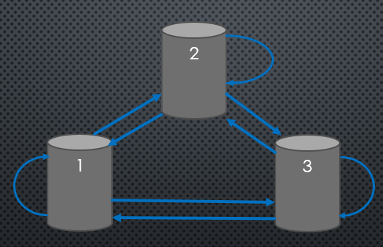
3 Problems: HMM
What is probability of generating an observation sequence given a model λ = (A, B, π) ? i.e p(O| λ)?
Given observation sequence what is most probable hidden q state sequence? Q=
Model Evaluation
0.6
Path analysis/
Decoding
0.6
argmax Q=(q_{1,}q_{2…..}q_{T})
How to determine modal parameters
λ = (A, B, π), given a training set of
observations to maximize P(O | λ) ?
Training

Slide 17
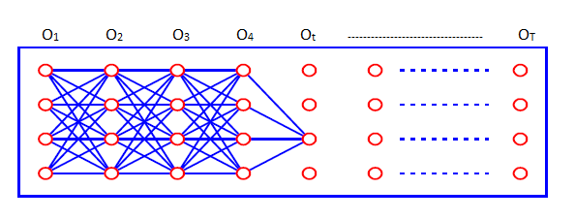
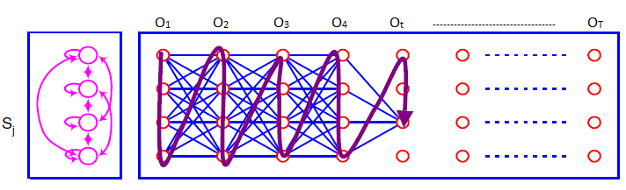
Solution 1:
Given a model λ
Observation sequence: O= O₁, O₂,.. O_{T}
P(O| λ ) = ?

Slide 18
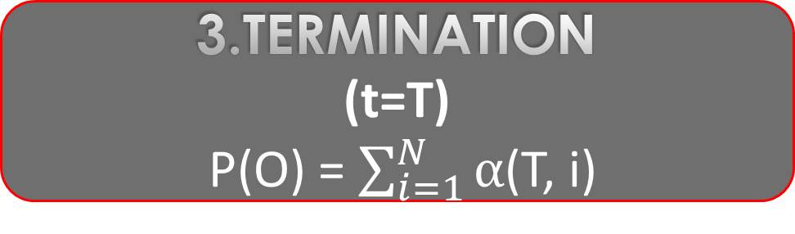
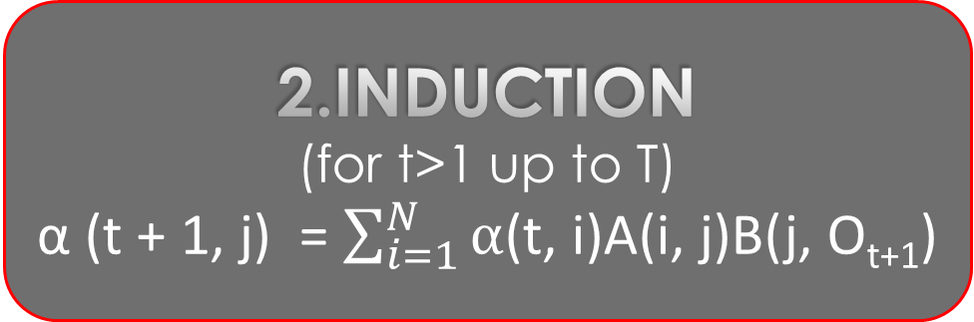
Forward Algorithm:
1.Initialization
α (1, i) = π_{i} B(i, O₁)
Define:
α (t, i) =P(O₁, O₂, O₃, … O_{T,} q_{T} = i )
α → joint probability of seeing a sequence we have observed till now and being in a specific state at that time ,(i is state)
2.Induction
(for t>1 up to T)
α (t + 1, j) = $\sum_{i=1}^{N}{α}$(t, i)A(i, j)B(j, O_{t+1})
3.Termination
(t=T)
P(O) = $\sum_{i=1}^{N}{α}$(T, i)

Slide 19
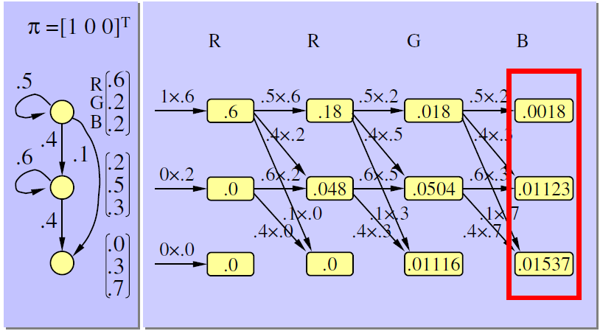
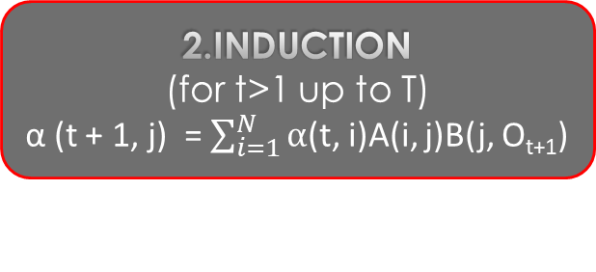
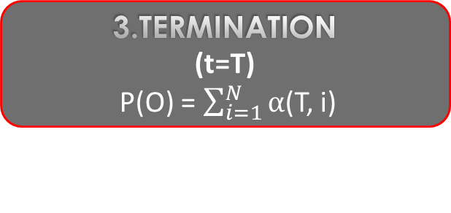
What is P(“R R G B"|λ)?
1.Initialization
α (1, i) = π_{i} B(i, O₁)
.5 .4 .1
0 .6 .4
0 0 0
.6 .2 .2
.2 .5 .3
0 .3 .7
B =
π =
1 0 0
A =
O_{t}= O_{t}= O_{t}= O_{t}=
2.Induction
(for t>1 up to T)
α (t + 1, j) = $\sum_{i=1}^{N}{α}$(t, i)A(i, j)B(j, O_{t+1})
3.Termination
(t=T)
P(O) = $\sum_{i=1}^{N}{α}$(T, i)
P(“R R G B"|λ) = .0018 + .01123 + .01537
=.0284

Slide 20
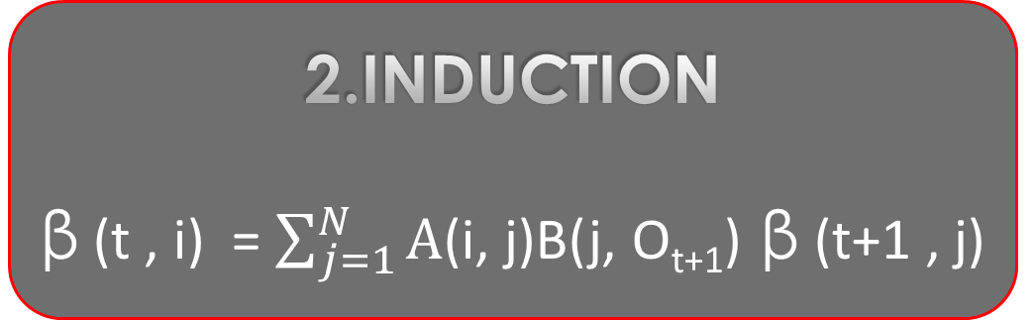
Backward Algorithm:
1.Initialization
β (T, i)=1
Define:
β (t, i) =P(O_{t+1}, …,O_{T} | q_{T} = I, λ )
Reverse of forward algorithm.
2.Induction
β (t , i) = $\sum_{j=1}^{N}{A}$(i, j)B(j, O_{t+1}) β (t+1 , j)

Slide 21
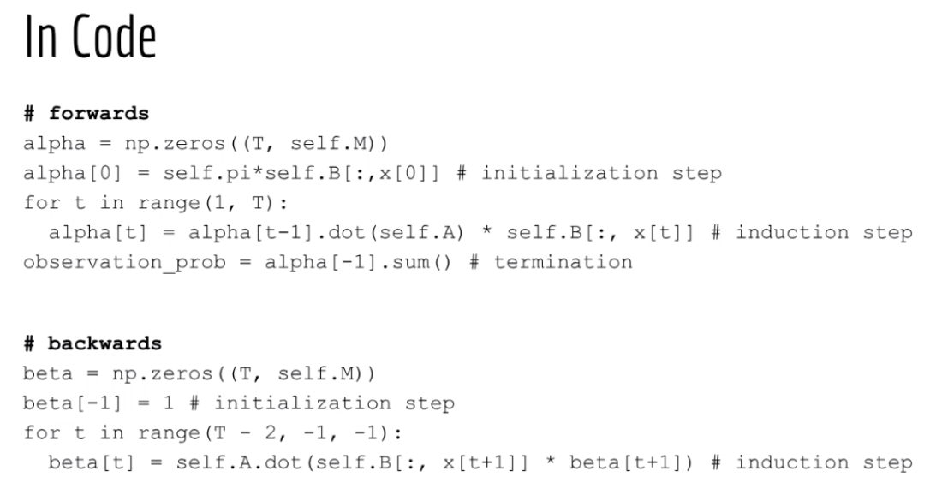

Slide 22
Viterbi Algorithm-Decoding
1.Initialization
δ(t,i) = π_{i} B(i, x(1))
ψ(1,i ) = 0
Similar to Forward algorithm instead of sum() we max()
we want the single most probable state sequence and its probability rather than the full probability
MUST keep a backpointer Ψ_{t}(j) from each max →recover the actual best sequence after termination.
2.Recursion
δ(t,j)=max_{1<i<N}{ δ(t-1,i)A(i, j)}B(j, x(t))
ψ(t,j)= argmax_{1<i<N}{δ(t-1,i)A(i, j)}
3.Termination
P* = max_{1<i<N} δ(T,i)
q_{T} = argmax_{1<i<N} δ(T,i)

Slide 23
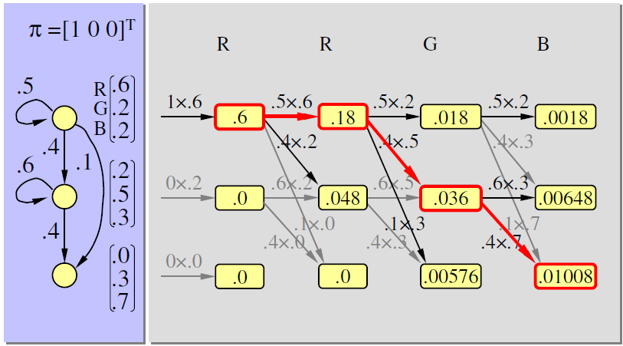
Viterbi Algorithm-Example
1.Initialization
δ(1,i) = π_{i} B(i, x(1))
ψ(1,i ) = 0
O_{t}= O_{t}= O_{t}= O_{t}=
2.Recursion
δ(t,j)=max_{1<i<N}{ δ(t-1,i)A(i, j)}B(j, x(t))
ψ(t,j)= argmax_{1<i<N}{δ(t-1,i)A(i, j)}
3.Termination
P* = max_{1<i<N} δ(T,i)
q_{T} = argmax_{1<i<N} δ(T,i)

Slide 24
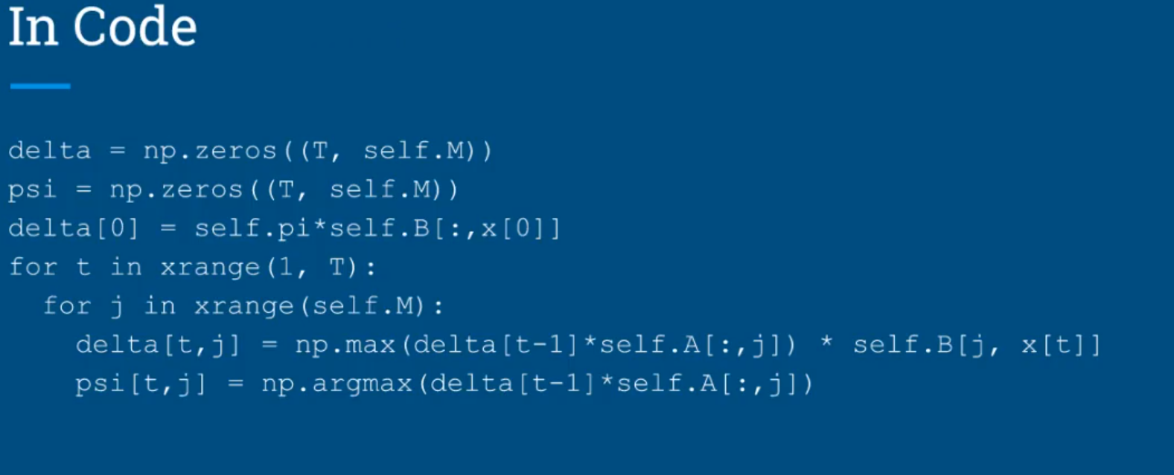
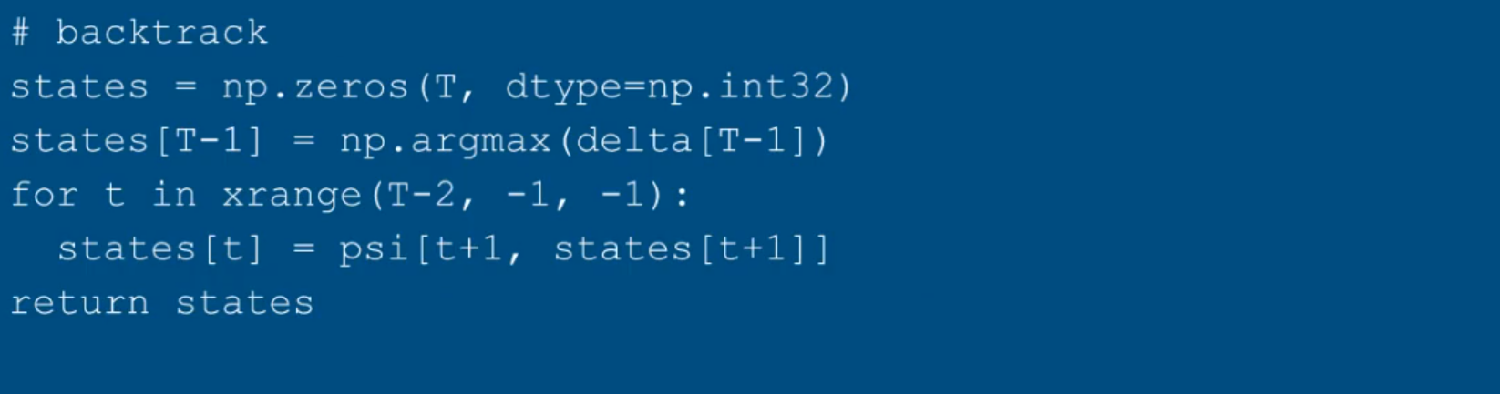

Slide 25

BAUM WELCH EM ALGORITHM: TRAINING
hmm parameters -this is the learning problem.
use heuristic methods, though partial solutions!!!!!
https://www.voiceofprophecy.com/articles/blog/unknown-ghost

Slide 26


EM ALGORITHM: TRAINING
GUESS Initial Parameter value→
re estimate iteratively till local maximum is reached→
Estimate likelihood of data
$\frac{α\left(t,i\right)A\left(i, j\right)B(j,x(t+1)β(t+1,j)}{\sum_{i=1}^{N}{\sum_{j=1}^{N}{A\left(i, j\right)B(j,x(t+1)β(t+1,j)}}}$
X(t+1)
1. ξ(t,i,j) =
q(t)=i
q(t+1)=j
2. γ(t,i) = $\sum_{i=1}^{N}{ξ (t,i,j) }$

Slide 27



UPDATE EQUATIONS
π_{i} = γ(1,i)
A(i, j ) = $\frac{\sum_{t=1}^{T−1}{ξ (t,i,j)}}{\sum_{t=1}^{NT−1}{γ(t,i)}}$
($\frac{expected no of transitions from Si to Sj}{expected no of transitions from Si}$)
HOLA!!!!!!
B(i, k) = $\frac{\sum_{t=1}^{T−1}{γ(t,i)} if x\left(t\right)=k ,else 0}{\sum_{t=1}^{NT−1}{γ(t,i)}}$
($\frac{expected no of times in state j and observing symbol k}{expected no of times in state j}$)

Slide 28
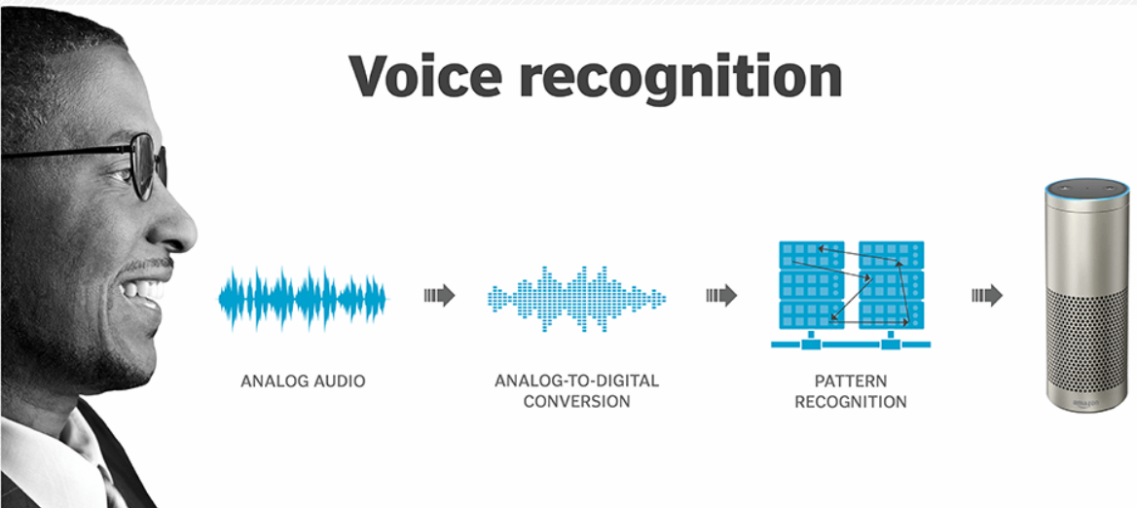
APPLICATIONS Speech Recognition
• Hidden states = , observed =
• We don't need any fancy algorithms to train
• We know the hidden states! (They are not really hidden)
• HMM = pi, A, B
• All can be calculated by just counting!
POS TAGS
WORDS
(EXPECTATION-MAXIMIZATION)
• Pi = frequency of start tags
• A = p(tag(t) I tag(t-1))
• B = p(word(t) I tag(t))

Slide 29
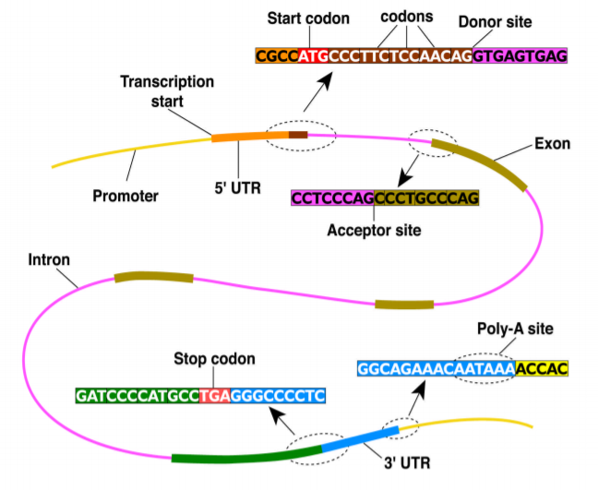
Other APPLICATIONS –
Gene Finding
Handwriting recognition
Pattern Recognition

Slide 30
References
Rabiner, L.R. A Tutorial on Hidden Markov Models and Selected Applications in Speech Recognition. IEEE 1989, 77, 257–286
https://pdfs.semanticscholar.org/9d0e/c3f52be23cbff7b430726f606831d497c96c.pdf
https://emunix.emich.edu/~sverdlik/CharRec.ppt
http://isoft.postech.ac.kr/Course/CS704/LectureNotes/HiddenMarkovModel.pdf
https://www.researchgate.net/figure/Hidden-Markov-Model_fig2_283103282
D.H. Kil and F. B. Shin, Pattern Recognition and Prediction with Applications to Signal Characterization American Institute of Physics, Woodbury, NY, 1996.
https://compbio.soe.ucsc.edu/html_format_papers/tr-94-24/node11.html
www.cs.umd.edu/~djacobs/CMSC828/ApplicationsHMMs.pdf
Viterbi, A.J. Error bounds for convolutional codes and an asymptotically optimal decoding algorithm. IEEE Trans. Informat. Theory 1967, IT-13, 260–269.
L.R. Rabiner and B.H. Juang, "An Introduction to Hidden Markov Models," IEEE ASSP magazine, Vol.3, No.1, pp. 4-16, 1986.
https://pdfs.semanticscholar.org/9d0e/c3f52be23cbff7b430726f606831d497c96c.pdf

Slide 31
Thank YOU

